Slide 1
Couch Potatoes With Python Billboard Top 10
By Aarnav, Seth, Ryan, and Swathi V.

Slide 2
Introduction
Core Research Question: Does a higher volume of song releases correlate directly with a more sustained, long-term presence on the Billboard Hot 10?
The "Quantity vs. Quality" Debate: Investigating whether market saturation (releasing more tracks) is a more effective strategy for career longevity than focusing on a few single "mega-hits."
Data-Driven Career Planning: Helping independent artists and major record labels optimize their release schedules to ensure steady industry growth.
The Dataset: Analyzing a comprehensive record of over 138,000 data points from Billboard archives, spanning from 2000 to the present.
Our Objective: Using computational modeling and linear regression to decode the mathematical path to mainstream success.
Notes:
So, our project looks at a question that's pretty relevant in today's music industry: does releasing more songs actually help artists stay successful on the Billboard Hot 10 for a longer period of time?
We often see artists taking different approaches. Some release music constantly to stay relevant, while others spend more time focusing on a few big hits. We wanted to see if one strategy actually performs better than the other when we look at the data.
This research could also be useful for independent artists and record labels because it provides a data-driven way to think about release strategies instead of relying on guesswork.
To answer our question, we analyzed over 138,000 Billboard Hot 100 records from 2000 to the present. Then we used statistical methods, including linear regression, to see whether there's a relationship between how much music an artist releases and how long they stay successful on the charts.

Slide 3
Why is this important?
For Artists: Determines whether a career will have a steady presence or rely on fleeting virality.
For Labels: Provides a data-driven justification for which artists to sign and distribute resources to.
Industry Trend: With the rise of streaming, "flooding the market" has become a strategy. We aim to validate if this leads to billboard dominance.
Notes:
This research is important because it helps us understand whether releasing more music actually leads to long-term success or just short-term attention. For artists, that can influence how they plan their careers. For record labels, it provides data to support decisions about which artists to invest in. It also helps explain whether today's streaming strategies are changing what it takes to reach the top of the charts.

Slide 4
Hypothesis
We hypothesize that a song's Debut Rank and Artist Chart History will have the highest positive correlation with its total weeks on the Billboard Hot 100 top 10.
Established artists carry built-in streaming momentum, and songs that debut high usually receive heavier playlist placement.
Notes:
To kick off our analysis, we formed a core hypothesis around two main drivers: Debut Rank and Artist History
Big-name artists don't start from scratch. They bring an established fan base that streams their music on day one.
On top of that, debuting high triggers heavy playlist placement on platforms like Spotify and Apple Music, creating a snowball effect for chart staying power.
Now, let's look at the data to see if our initial assumptions actually held up.

Slide 5
Data collection
Finding: The data itself was quite easy to find online from Kaggle but it wasn't fully clean and useful.
Cleaning: We had to remove the data from the sheet that told us the movement of each song which was not useful for this project.
Simplifying: Then noting that the data went to 1958 we decided to only use data that was after 2000
Correcting: As well as to keep making sure only the top 10 of the billboard was being using in the code. Another issue was that it could have been counting someone multiple times per week based on them having many songs in the top 10, but this issue didn't really pop up
Cutting: There were collaborations that counted as singular artists not each artist themself, so for simplicity we cut those songs out.
Notes:
For the Correcting section mention how we made code to fix the issue of it counting people multiple times but nothing changed in the results, showing that it wasn't an issue or was solved accidentally from other parts of the cleaning.
We scraped and cleaned historical Billboard Hot 100 data to build a reliable dataset.
Duplicate entries were removed, and metrics were aggregated at the artist level.
This gave us a clean foundation to measure both song-level and artist-level chart lifespans.

Slide 6
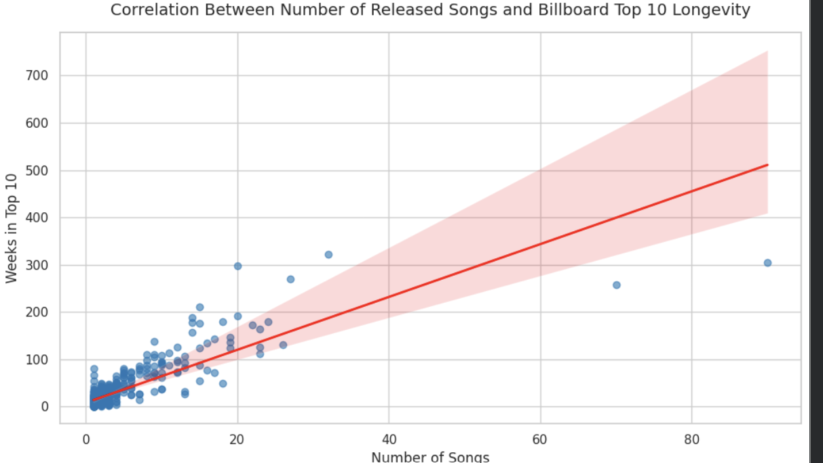
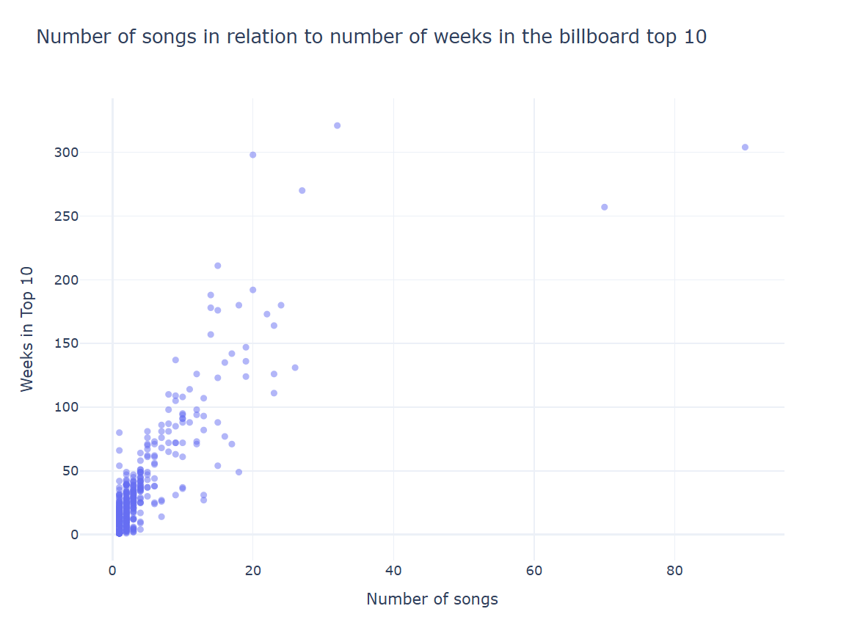
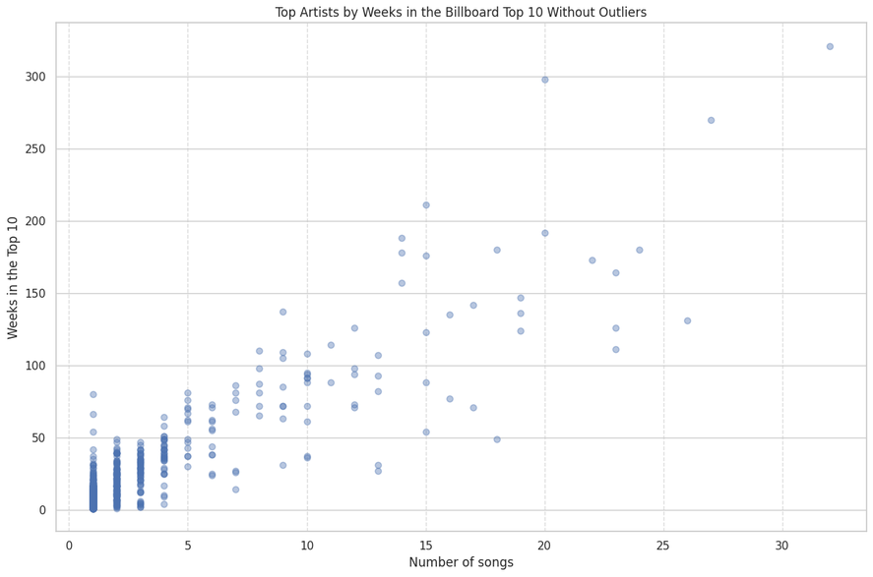
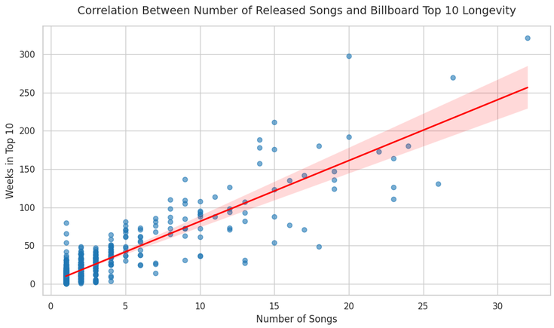
Data exploration
Patterns:
  Areas of Congregation
  High correlation
Outliers: Drake & Taylor Swift
Notes:
Increase in number of songs = Increase of number of weeks on Billboard
Majority of artists have < 10 songs on Billboard, and stay for a little less than 50 weeks
Overlapping area where many points are congregated (points more spread out as number of songs increase)
Drake & Taylor Swift: (More songs and less time), does not fit the trend
Degree of Relation:
weeks_on_billboard = 1.000000 or 0.887705
num_songs = 0.887705 or 1.000000
Mean:
weeks_on_billboard = 24.413613
num_songs = 2.925393
Median:
weeks_on_billboard = 12.0
num_songs = 1.0
Mode:
weeks_on_billboard = 1
num_songs = 1

Slide 7
Key Success Metrics
Average Weeks: The mean time a single song by an artist remains on the top 10.
Unique Hits: Total count of different songs an artist has successfully charted.
Cumulative Stay: Total lifespan of an artist's brand across the entire Billboard ecosystem.
Notes:
We defined three core metrics to evaluate success: Average Weeks, Unique Hits, and Cumulative Stay.
Average Weeks shows song-level sticky power, while Unique Hits measures output.
Together, they feed into Cumulative Stay—the ultimate measure of an artist's brand footprint on the charts.

Slide 8
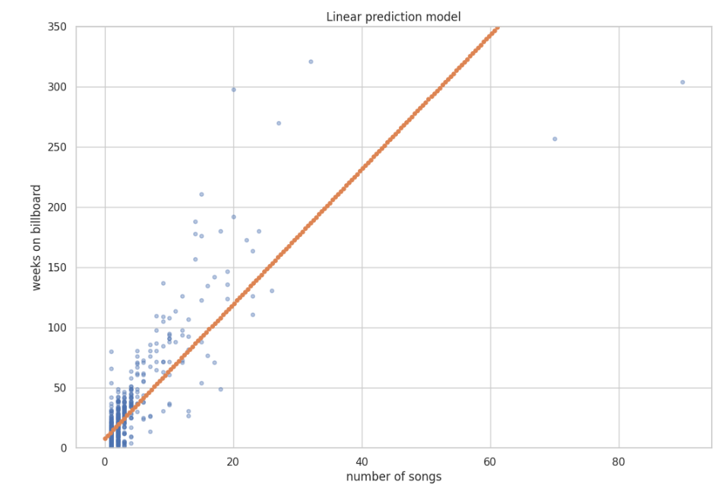
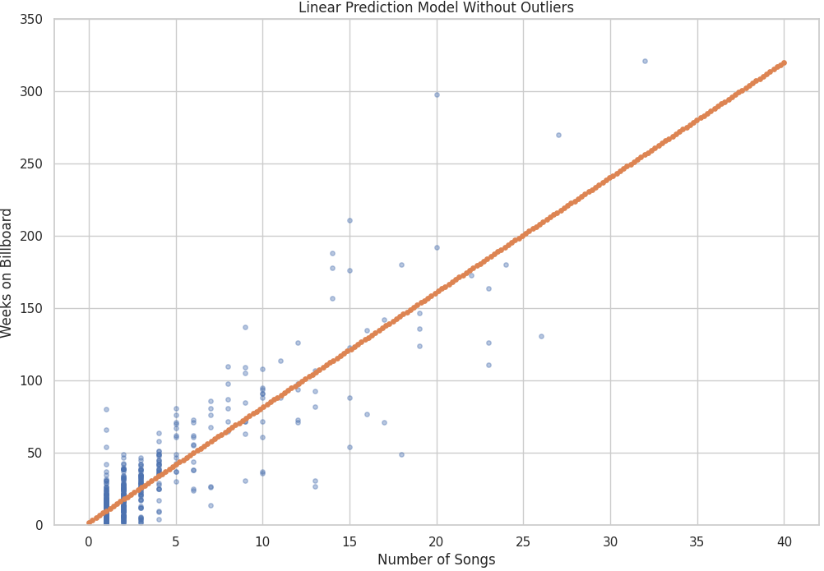
Models
Input: Number of songs on billboard
Predicts: Number of weeks on billboard
Model type: Linear regression
Preprocessing: Cleaned and simplified data. Removed outliers.
Assumptions:
  Know the number of songs.
  The outliers shouldn’t be taken into account in the prediction.
  The two variables are causal
Notes:
Seth
The input of the model is the number of unique songs an artist has on the top ten of the billboard top 100
The output of the model is the number of weeks the artist has been on the top 10 of the billboard top 100
These inputs and outputs are used because the number of unique songs on the billboard is more likely to be present before you know the number of weeks that they are on the billboard which allows it to be used as a prediction.
The model type is a linear regression model because looking visually at the data it looks to be approximately linear so a linear regression model will give a good prediction without risking overfitting
The preprocessing includes the previously discussed cleaning of the data through removing collaborations and the simplification of data through only including the top recent hits.
We also had preprocessing to remove the outliers in the data for one of the models because for a predictive model outliers aren’t helpful.
An assumption made in this model is that we know the number of songs on the billboard which means it's only good for semi-established artists
Additionally since this prediction model doesn’t remove outliers it assumes that they should be taken into account and could skew the model to believe that artists will get slightly less weeks than they do
In a similar way to knowing the number of songs. We also assume that the number of songs directly causes the number of weeks instead of the correlation being from a less straightforward more intertwined reason where they both cause each other.

Slide 9
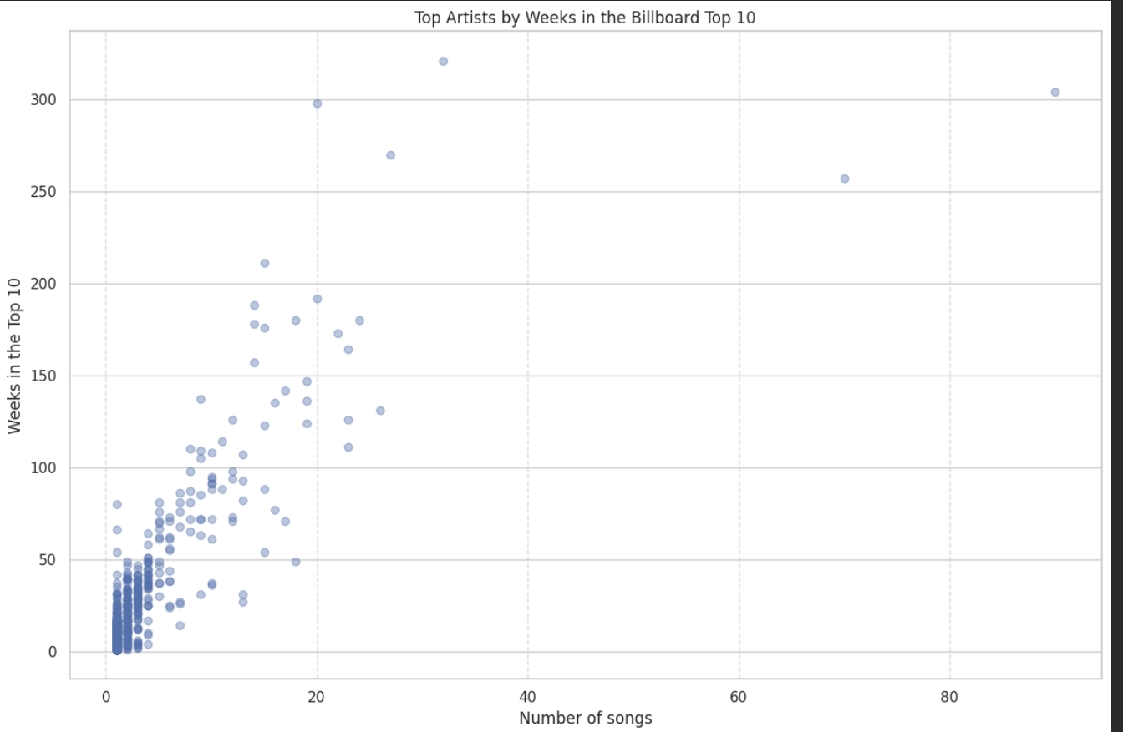
Visualizations
Notes:
This scatter plot maps out Number of Songs on the x-axis against Weeks in the Top 10 on the y-axis.
Most artists cluster in the lower-left corner, staying in the Top 10 briefly across a small handful of tracks.
As we move up and to the right, we see clear outliers—artists who combine heavy song volume with massive chart longevity.
It highlights a key takeaway: while having more hit songs generally increases total chart time, a select few 'forever hits' allow certain artists to punch way above their weight.
A design decision that was made was to lower the opacity off the points in order to make it clear that there is a denser cluster in the bottom left with few songs for a short amount of time
The ink to data ratio was improved through having a clear background and not including any more variables than necessary
Removing the outliers helped raise the voice of the visual through emphasizing the linear trend and allowing the visual to be enlarged.
Chosen over a bar graph as it plots all the artists rather than just the 20 artists that have spent the most weeks on the Billboard

Slide 10
Interactive Sheet
Link to the colab
https://colab.research.google.com/drive/1CxEYR7OIM7GCM5vCyCL40Y1YCBRNkjul#scrollTo=6qlwCb8bF2OF

Slide 11
Link to our CoLab
https://colab.research.google.com/drive/1ohryqkgnMCZuXmBXEzBi2WImU2dLQh6a

Slide 12
Conclusions
Does a higher volume of song releases correlate directly with a more sustained, long-term presence on the Billboard Hot 10?
More unique songs predicts more unique weeks
Very popular artists have longer staying power
Likely an effective strategy to flood the market with many songs
Notes:
The high correlation between songs and weeks allows for an effective prediction of the number of weeks a new artist on the billboard might stay on
Popular artists with many popular songs such as taylor swift and drake are on the billboard for many weeks
More songs increase chances of having more songs on the billboard which allows for more staying power and popularity

